Slide 1

Task 26
MongoDB CRUD Operations and Data Aggregation Task
Name: Basel Amr Barakat
Email: baselamr52@gmail.com

Slide 2
Task Overview
Objective: Utilize MongoDB's CRUD operations and aggregation framework to manage and analyze data effectively.
Key Goals:
Perform CRUD Operations (Create, Read, Update, Delete)
Perform Aggregation Tasks (Average Age, Sorting, Filtering)
Gain Insights (Youngest and Oldest Group)

Slide 3
Requirement One
MongoDB Setup and CRUD Operations

Slide 4



1.1 Database and collection Creation
1.2 Insert Sample Data
1.3 Read, Update and Delete Data

Slide 5
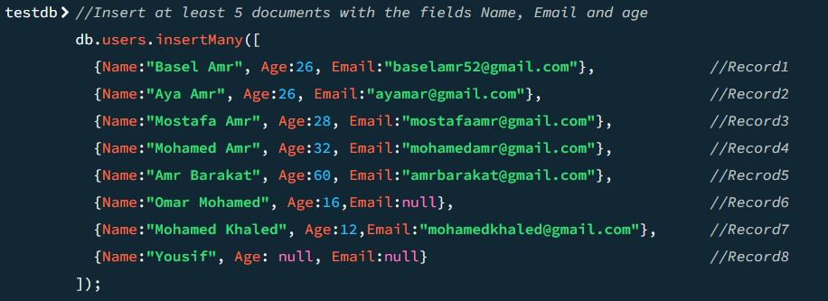
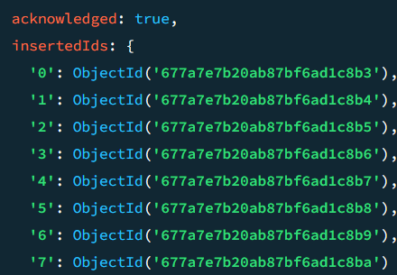
1.1 Database and collection Creation
1.2 Insert Sample Data

Slide 6
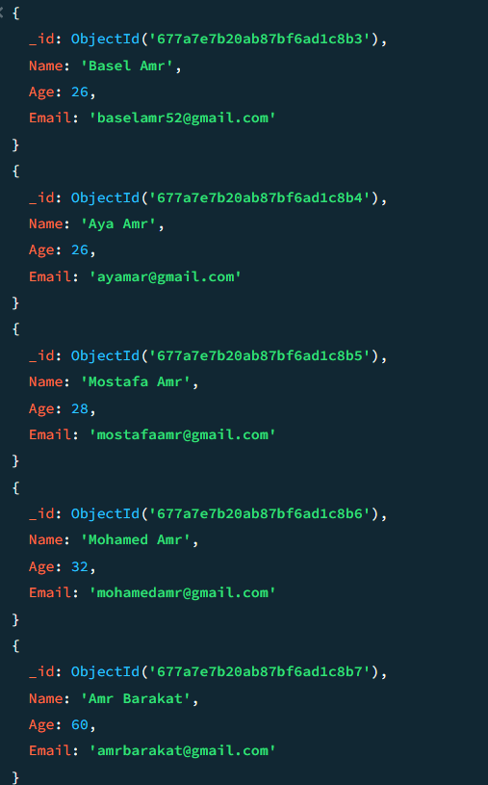
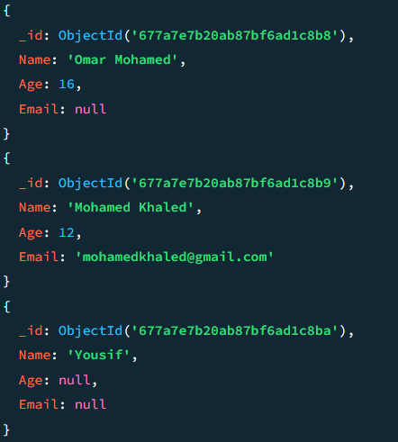
1.3 Retrieve all documents from the users' collections

Slide 7
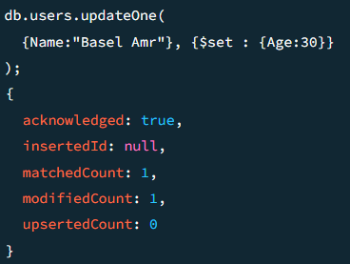
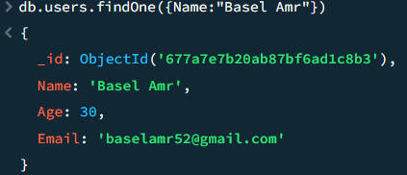
1.4 Update the age of one user to be 30

Slide 8
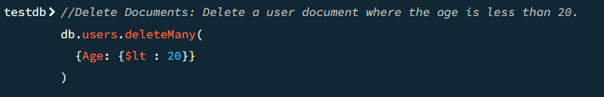
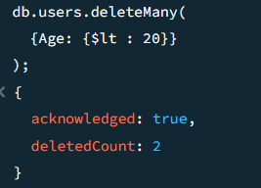
1.5 Delete all users based on a specific condition (age<20)

Slide 9
Requirement Two
Aggregation Tasks

Slide 10
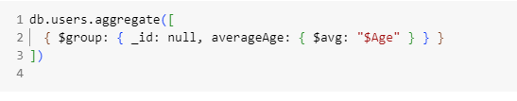
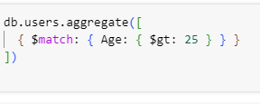

2.1 Use MongoDB’s aggregation framework to calculate avgAge
2.2 Use the aggregation framework to find users > 25 years old
2.3 Sort the users in descending order of their age

Slide 11
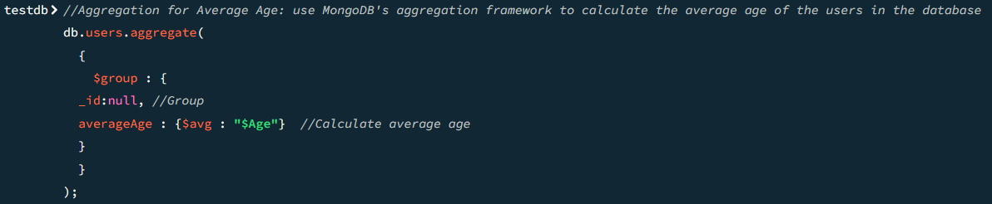
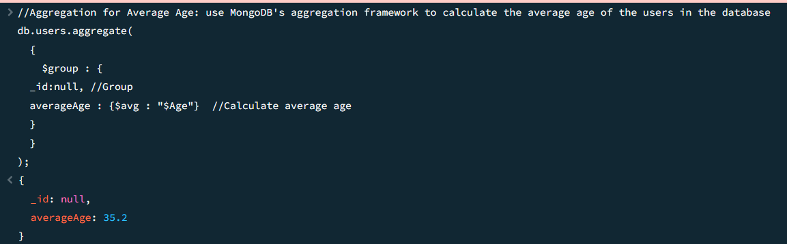
2.1 Use MongoDB’s aggregation framework to calculate avgAge

Slide 12
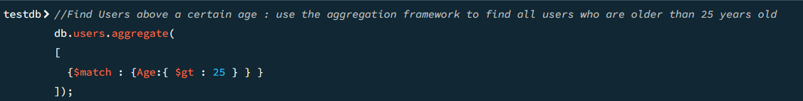
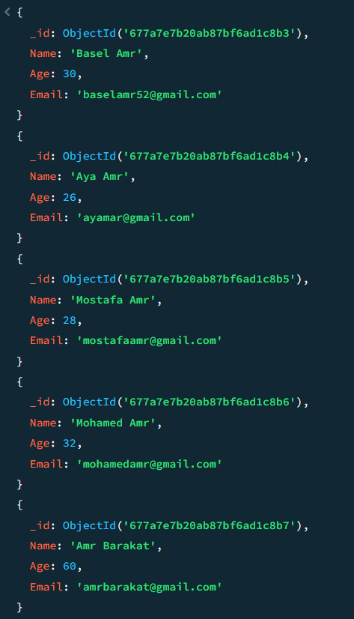
2.2 Use the aggregation framework to find users > 25 years old

Slide 13
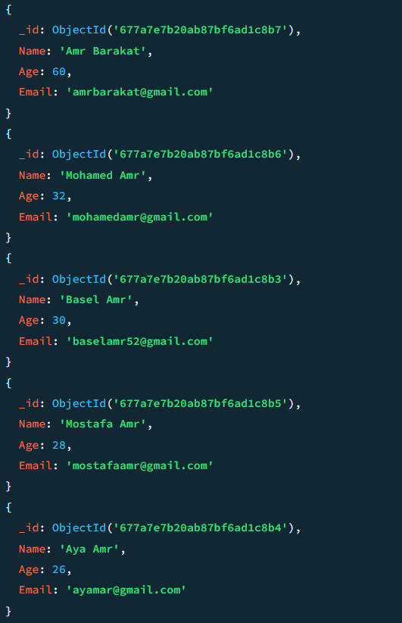
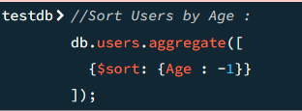
2.3 Sort the users in descending order of their age

Slide 14
Requirement Three
Data Insights and Analysis

Slide 15
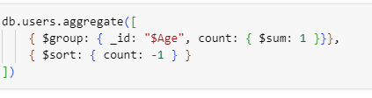
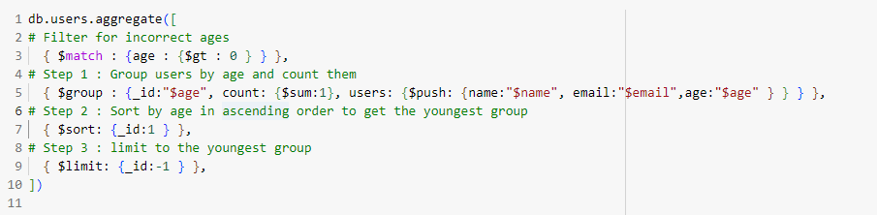
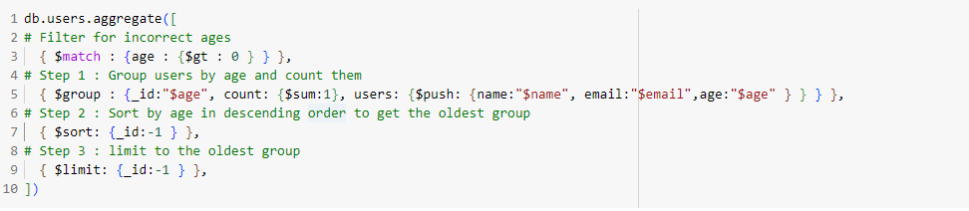
3.1 Group the users by age and count how many users in each age group
3.2 Combine multiple aggregation stages (like $match, $group and $sort) to get more insightful analysis

Slide 16
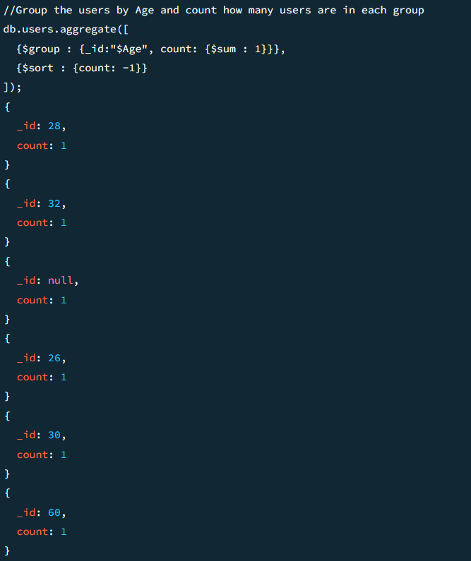
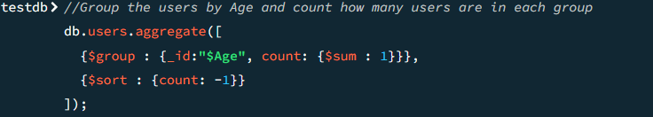
3.1 Group the users by age and count how many users in each age group

Slide 17
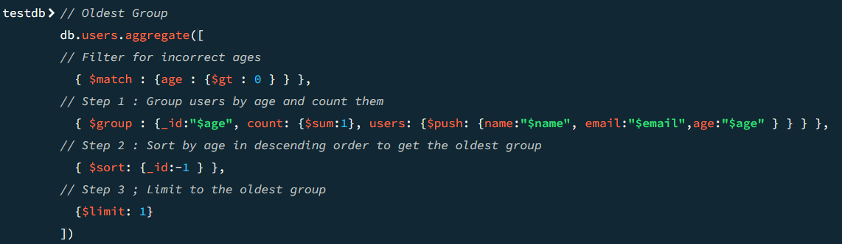
3.2 Combine multiple aggregation stages (like $match, $group and $sort) to get more insightful analysis

Slide 18
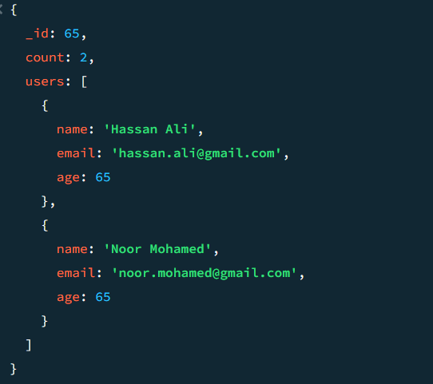
3.2 Combine multiple aggregation stages (like $match, $group and $sort) to get more insightful analysis

Slide 19
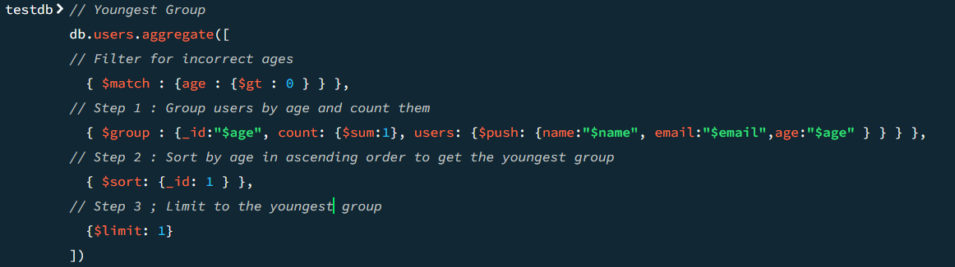
3.2 Combine multiple aggregation stages (like $match, $group and $sort) to get more insightful analysis

Slide 20
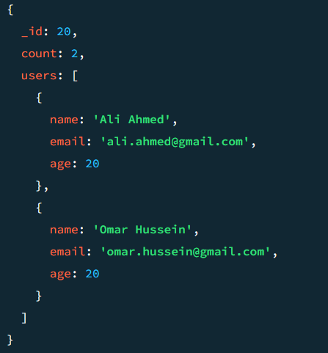
3.2 Combine multiple aggregation stages (like $match, $group and $sort) to get more insightful analysis

